Slide 1
Lecture 3 Regular Expressions
Regular Languages
regular expressions
their equivalence and
pumping lemma

Slide 2


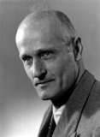
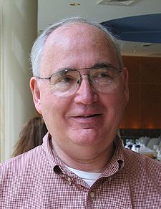
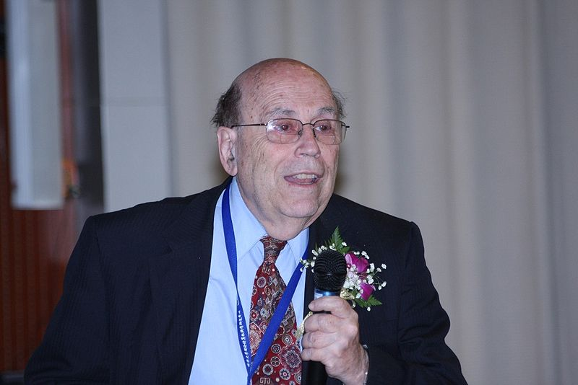
Theory at Princeton: early period
Alonzo Church
Turing
Kleene
Scott
Rabin

Slide 3
Equivalence of NFAs and DFAs
Every nondeterministic finite automaton has an equivalent deterministic finite automaton.
Proof: Subset construction by Scott and Rabin(1959).

Slide 4
Summary
DFA’s, NFA’s both accept exactly the same set of languages: the regular languages (next time).
The NFA types are easier to design and may have exponentially fewer states than a DFA. Nondeterminism is a synonyms for guess or search.
But only a DFA can be implemented!

Slide 5
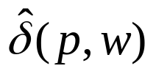
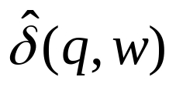
Equivalence
Given a DFA, two states p and q are equivalent if
For all input strings w, is an accepting state iff is an accepting state.
w
p
…..
q
w

Slide 6
Example
1
0
A
B
1
C
0
D
0
c
1
0
1
0
1
E
F
G
0
H
1
1
0
1
0

Slide 7

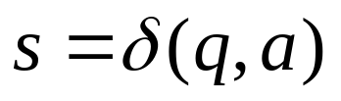
Distinguishable states
Base case: If p is an accepting state and q is a nonaccepting, then the pair {p,q} is distinguishable;
Induction case: Let p and q be states such that for some input symbol a, and are a pair of distinguishable states. Then {p, q} is a pair of distinguishable states.
Are accepting states indistinguishable?

Slide 8
Table-filling algorithm (Where should we start?)
 | A | B | C | D | E | F | G | H
A
B | x
C | x | x
D | x | x | x
E |  | x | x | x
F | x | x | x |  | x
G | x | x | x | x | x | x
H | x |  | x | x | x | x | x
Why does this algorithm give the minimal automata?

Slide 9
Testing equivalence of DFAs
Recall that
two DFAs are equivalent if they accept the same language.
Testing equivalence of DFAs can be transformed into testing equivalence of their starting states.

Slide 10
Example: Two equivalent DFAs
Does this approach work for NFA?
0
1
start
A
1
B
0
start
C
0
D
0
0
1
1
It suffices to show that the starting
states are indistinguishable.
E
1

Slide 11

Design Automata
Suppose Construct a finite automaton M recognizing the following languages:
A is the set of all strings with an odd number of 1’s.
A is the set of all strings 001 as a substring
A is the set of all strings except 11 and 111
The set of all strings except the empty string
How do you know which one among equivalent automata is the minimal or the optimal?
Is there an algorithm for designing automata?

Slide 12


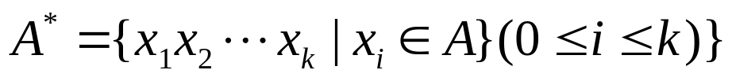
Regular languages and Regular Operations
A languages is called a regular language if some finite automaton recognizes it.
Let A and B be two languages,
Union:
Concatenation:
Star:
The empty string always belongs to A*.

Slide 13

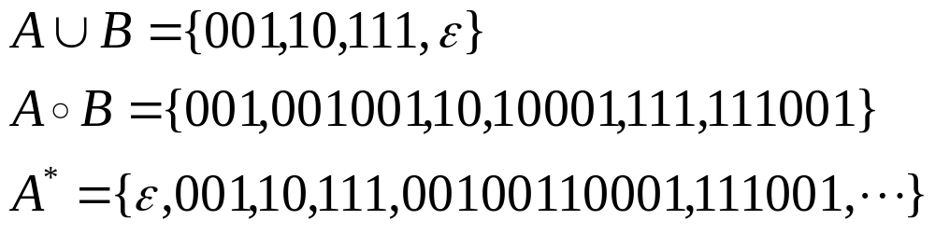
Example
Let A ={001, 10, 111},B={ ,001}
Then

Slide 14

Closure Properties
The class of regular languages is closed under union operation, and concatenation and star.
That is to say, if both A and B are regular languages, so are
Where did we use Empty string + Non-determinism in the proof?

Slide 15

An illustration: Closed under union
M
M1
….
……
M2
What if we don't use the empty string?

Slide 16
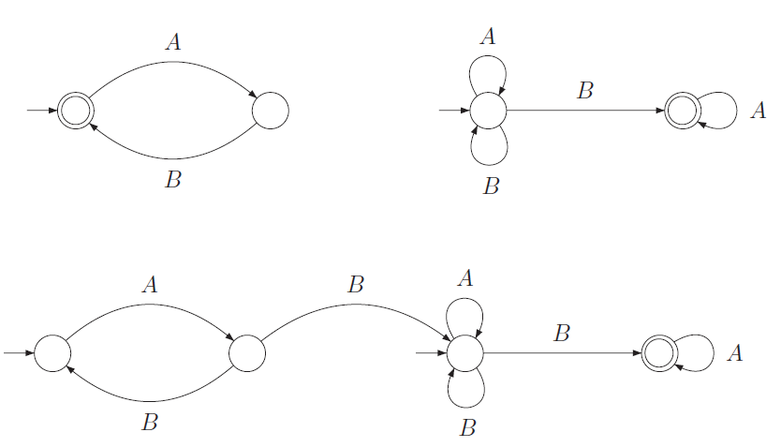
Concatenation: without epsilon

Slide 17
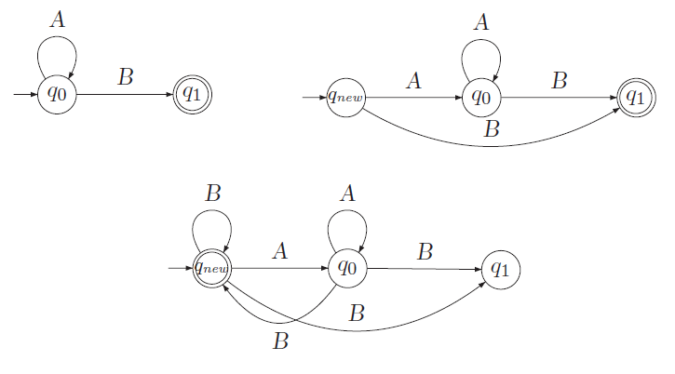
Star-operator: without epsilon

Slide 18









Regular Expressions (Structural Induction)
R is a regular expression if R is
a for some a in the alphabet set
The empty string ,
Empty set
, where and are regular expressions
where and are regular expressions
where is a regular expression
Let R be a regular expression. L(R) denotes the language represented by R.
Basis
Induction
What (regular) languages do they represent?

Slide 19
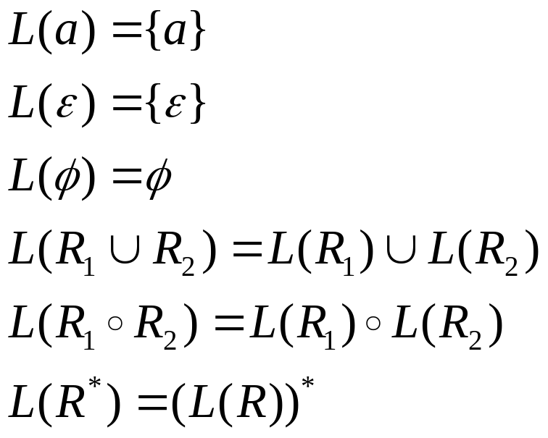
Languages described by regular expressions
In parallel to the inductive definition of regular expressions, the corresponding languages are

Slide 20

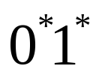
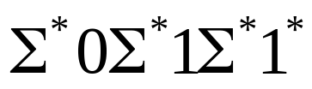
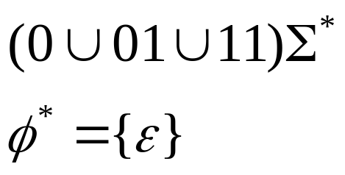


Example: Kleene Star
Let
Then describe the following languages
What are the differences between the empty expression
and the empty string

Slide 21
Equivalence
Main Theorem: A language is regular (i.e.,recognized by a finite automaton) if and only if some regular expression describes it.

Slide 22
The right-to-left is easy
According to the closure properties of the class of regular languages, we only need to show the basis cases
R =a some letter in the alphabet set.
R=the empty string
R=the empty expression
a
This is a proof
by structural induction!

Slide 23
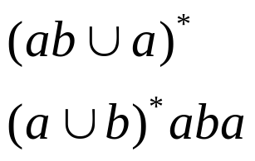
Example
Build NFAs from the following regular expressions

Slide 24
The poof of the other direction is hard
Proof Idea: Given a deterministic FA,
first we construct an equivalent generalized nondeterministic FA (GNFA)
next construct an equivalent GNFA by decreasing the number n of states one by one until n=2
Obtain the regular expression from the 2-state DNFA

Slide 25

Generalized nondeterministic FAs
A generalized nondeterministic FA is a nondeterministic FA wherein the transition arrows may have any regular expressions as labels.
Further we require GNFA satisfy the following three conditions:
The start state has transition arrows going to every other state but no arrows coming in from any other state:
The dual condition for the accept state, the start state is different from the accept state;
Except for the start and accept states, one arrow goes from every state to every other state and also from each state to itself.
Are these requirements reasonable?

Slide 26

Example: GNFA
aa
ab*
qstart
a*
(aa)*
qaccept
0
b
ab

Slide 27
Crucial step
R4
qi
qj
qi
R1(R2)*(R3)\/(R4)
qj
R1
R3
q0
R2
What if qi = qj?

Slide 28
Converting DFAs to Regular expressions
Example: a 3 state DFA
a
1
2
b
a
b
a
b
3

Slide 29
Automata = Regular expressions
In what sense?
Scott&Rabin
DFA
NFA
=
||
||
How do we arithmetize FAs?
Regular
Expressions
GNFA
=
Kleene

Slide 30
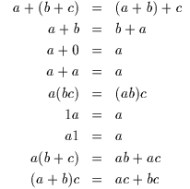

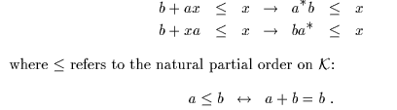
Kleene algebra: the algebra for regular expressions (Dexer Kozen 1994)
Exercise: Prove that (a*b*)* = (a+b)*

Slide 31
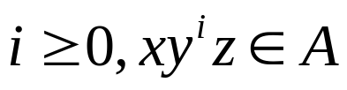


Pumping Lemma: necessary cond.
Negative results delineate the limits of computations!
If A is a regular language, then there is a number p (the pumping length) where, if s is any string in A of length at least p, then s may be divided into three pieces, s=xyz, satisfying the following conditions:
For each
, and
.

Slide 32
Proof Idea
s=s1 s2 s3 s4 s5 s6….sn string in A
q1 q3 q20 q9 q17 q9 q13 state
P is the number of states
y
x
q9
q1
z
q13
q9 is the first state that repeats

Slide 33
Proof steps
Proof by contradiction: B is nonregular
First assume the language B is regular and apply the pumping lemma to obtain the pumping length p
Next find a string s in B of length at least p which cannot be pumped.
Discuss s in several cases
So we arrive at a contradiction. Conclude that B is NOT regular

Slide 34
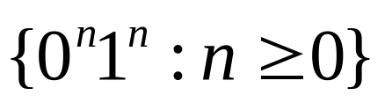
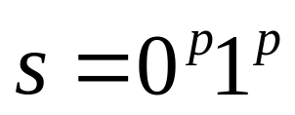
Example
Show that the language is not regular
Proof by contradiction: Suppose that it were regular. Let p be the pumping length given by the Pumping Lemma. Consider the string
y consists only of 0s;
Y consists only of 1s;
Y consists of both 0s and 1s.
We arrive at a contradiction. So it is not regular.
Discuss in cases

Slide 35
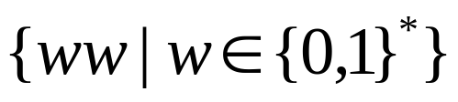
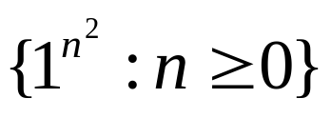
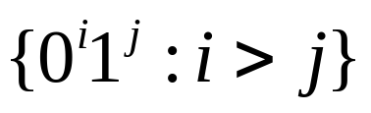
More examples
Prove that the following languages are not regular:
C={w|w has an equal number of 0s and 1s}.
F =
D =
E=
Exercises: 1.6(a)(b)(c), 1.7(a)(b)(c) 1.16, 1.19, 1.21,1.29(a)(b)

